Slide 1
SEA Team
Twitter sentiment Extraction

Slide 2
Twitter sentiment Extraction
In this competition you will need to pick out the part of the tweet (word or phrase) that reflects the sentiment.
What words in tweets support a positive, negative, or neutral sentiment? How can we help make that determination using machine learning tools?
Our objective in this competition is to construct a model that can look at the labeled sentiment for a given tweet and figure out what word or phrase best supports it.

Slide 3
Primitive model
“ using spacy “
NER Problem
Importing Necessities
Reading data
Data visualization
Build model
Train model
Run test

Slide 4
NER problem :
Named-entity recognition (NER) is a subtask of information extraction that seeks to locate and classify named entity mentioned in unstructured text into predefined categories such as person names, organizations, locations, medical codes, time expressions, quantities, monetary values, percentages, etc.

Slide 5
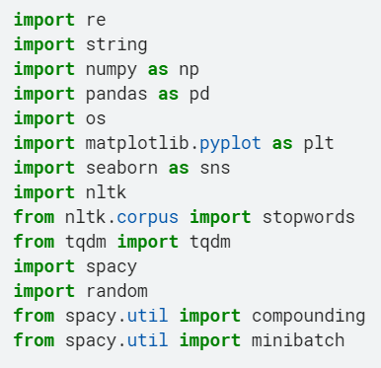
Importing Necessities
Import spacy library.

Slide 6
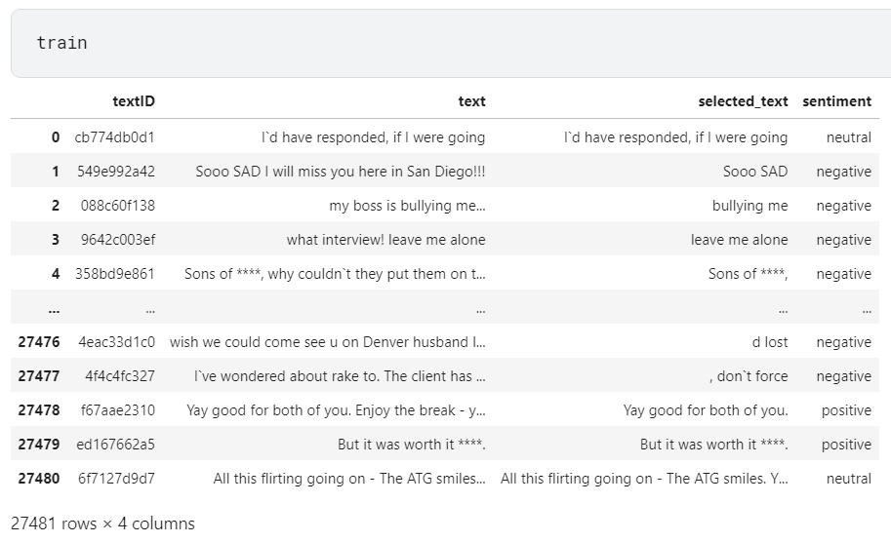
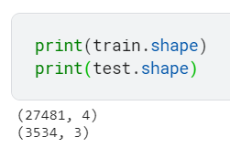
Reading data

Slide 7
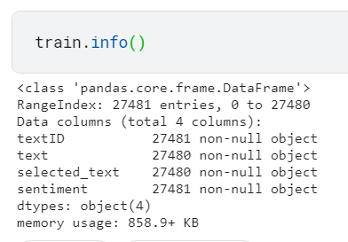
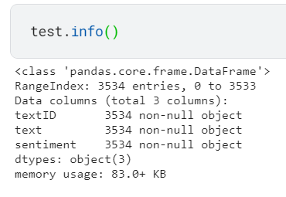

Data Visualization
Null rows should be dropped
No Null Rows

Slide 8
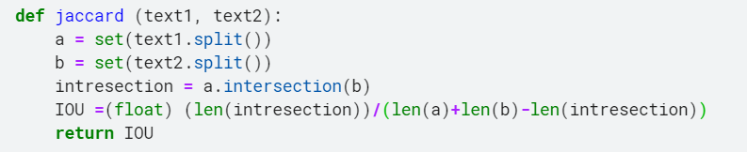
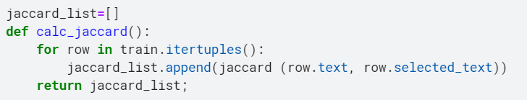


Jaccard Coefficient :
Implementing Jaccard by calculating intersection over union .
applying jaccard between text and selected text.
Calculating jaccard and inserting it as column in train data .

Slide 9
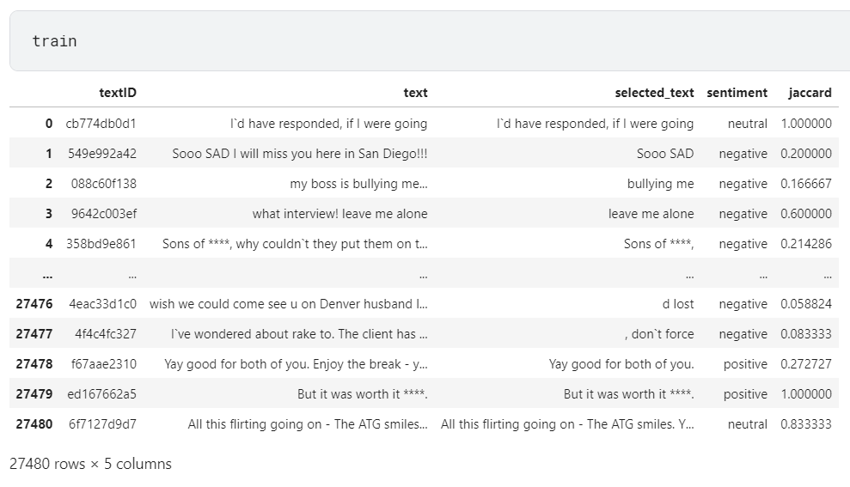
Jaccard Coefficient :

Slide 10
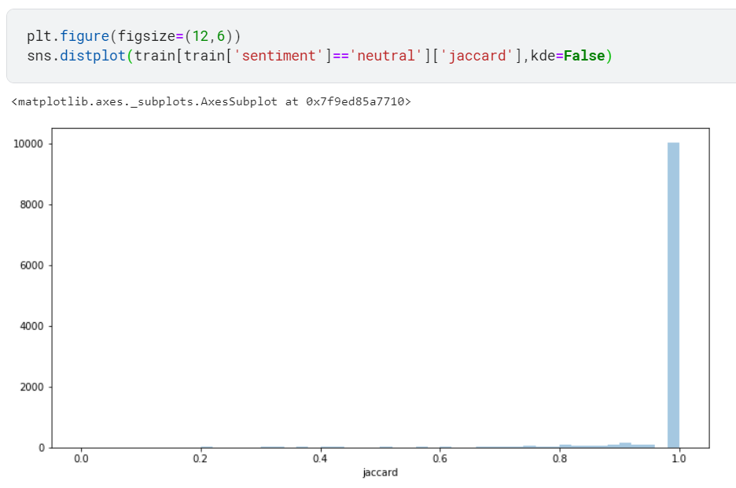
Jaccard Coefficient :
Plotting jaccard of neural tweets .

Slide 11
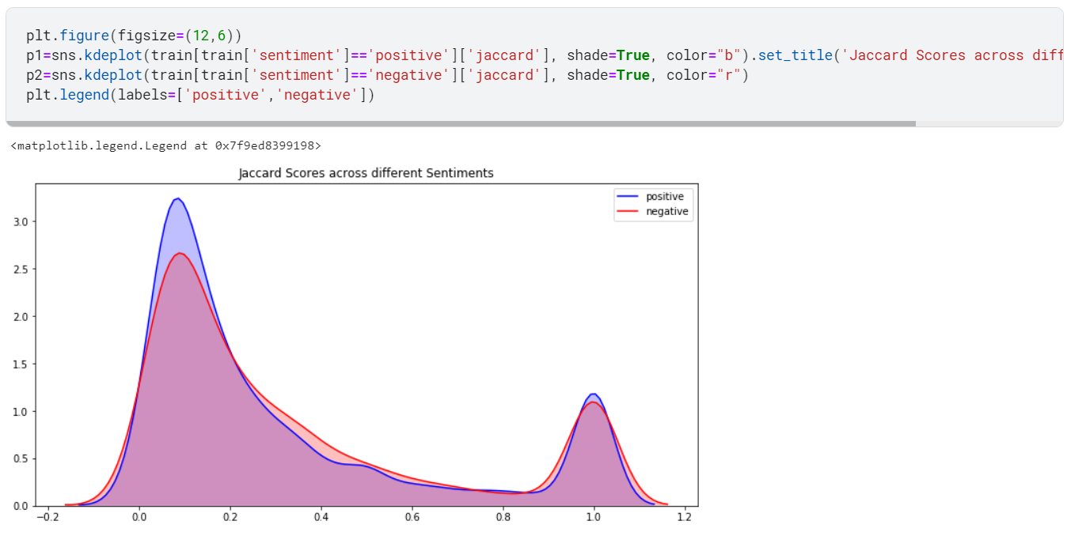
Jaccard Coefficient :
Plotting jaccard of positive and negative tweets .

Slide 12
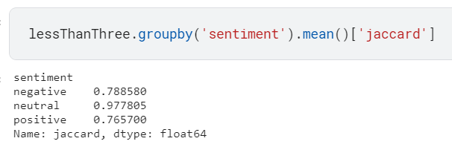
Jaccard Coefficient :

Slide 13
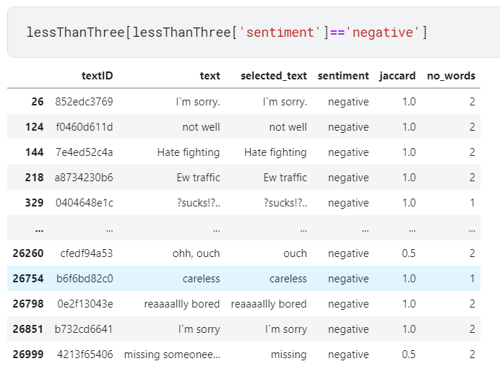
Jaccard Coefficient :

Slide 14
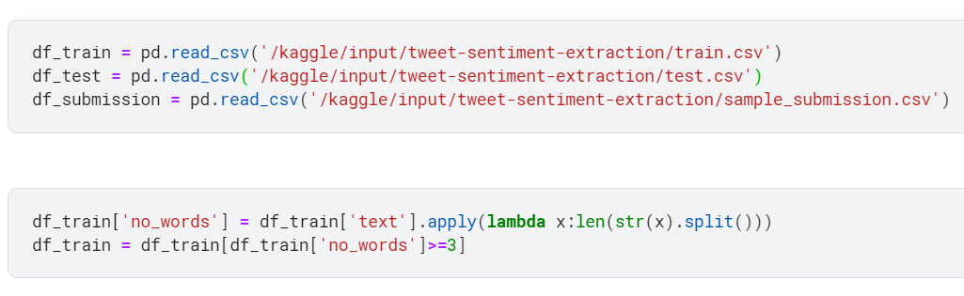
Train data with number of words greater than 2 :

Slide 15
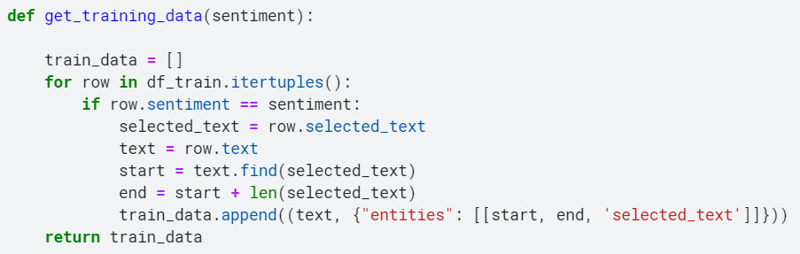
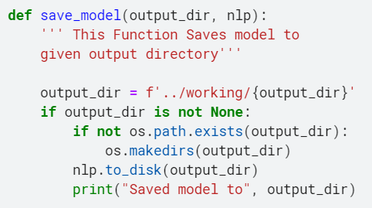
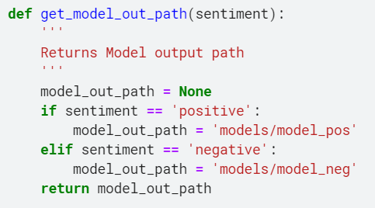
Helping Functions :

Slide 16
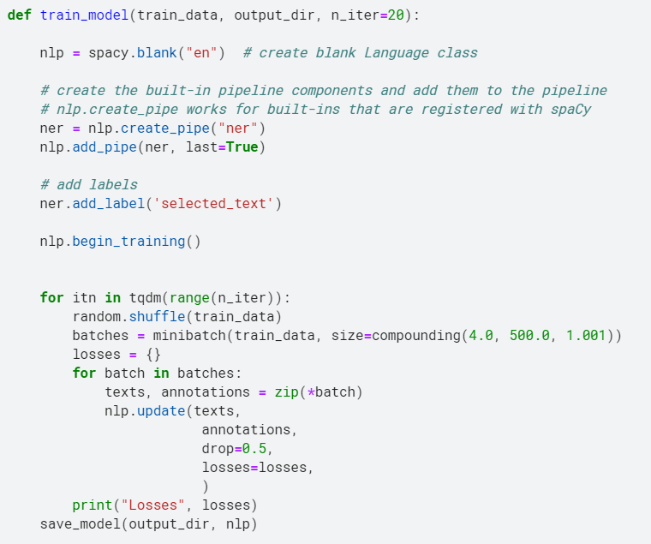
Train model :

Slide 17
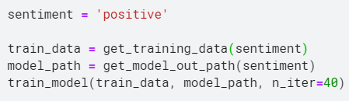
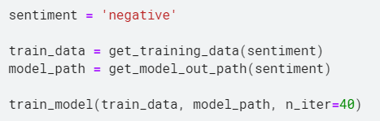
Implementing 2 models (positive/negative) with number of iterations 40 :

Slide 18
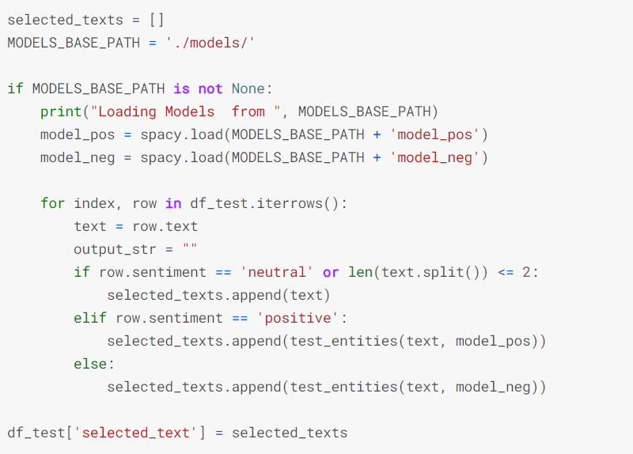
Predict the selected text to the test tweets :

Slide 19
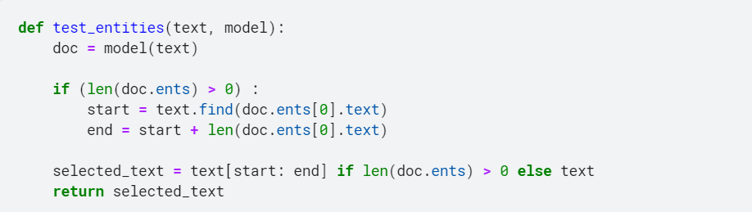
Predict the selected text :

Slide 20

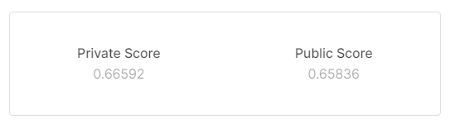
Submit the model :
Submission result :

Slide 21
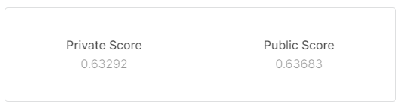
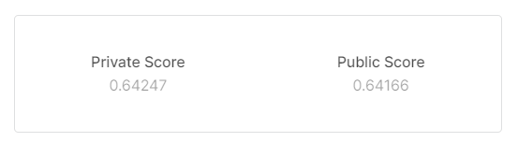
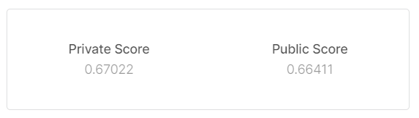
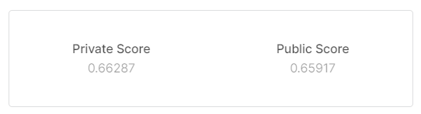
Changing number of iterations of train model :
n_iter = 1
n_iter = 5
n_iter = 50
n_iter = 60

Slide 22

Only in range of 60 % :
Let’s change the model

Slide 23
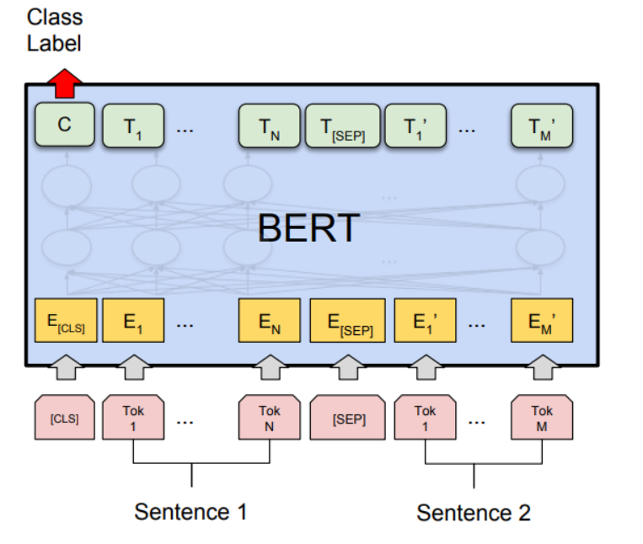
BERT Language Model :
BERT “Bidirectional Encoder Representations from Transformers” is an open source machine learning framework for NLP.
It is based on Transformers, a deep learning model in which every output element is connected to every input element, and the weightings between them are dynamically calculated based upon their connection.
Historically, language models could only read text input sequentially either left-to-right or right-to-left but couldn't do both at the same time. BERT is different because it is designed to read in both directions at once.

Slide 24
RoBERTa Language Model :
RoBERTa “Robustly Optimized BERT Pretraining Approach” .
It builds on BERT and modifies key hyperparameters, removing the next-sentence pretraining objective and training with much larger mini-batches and learning rates.
RoBERTa has the same architecture as BERT, but uses a byte-level BPE as a tokenizer and uses a different pre training scheme.
The goal of RoBERTa is to optimize the training of BERT architecture in order to take lesser time during pre-training .

Slide 25
To call Roberta model :
Data should be prepared as follow :
Input_ids : [0] + id of text + [2,2] + id of selected text + [2]
Attention mask :only length of Input_ids is set to 1 as The loss function while calculating it considers only the prediction of masked values and ignores the prediction of the non-masked values .
Start_tokens : vector of zeros except for the index of start of selected text in the text plus 1 .
End_tokens : vector of zeros except for the index of end of selected text in the text plus 1 .

Slide 26
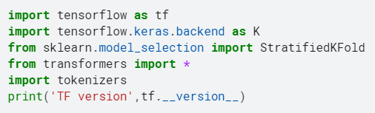
Import another libraries :

Slide 27
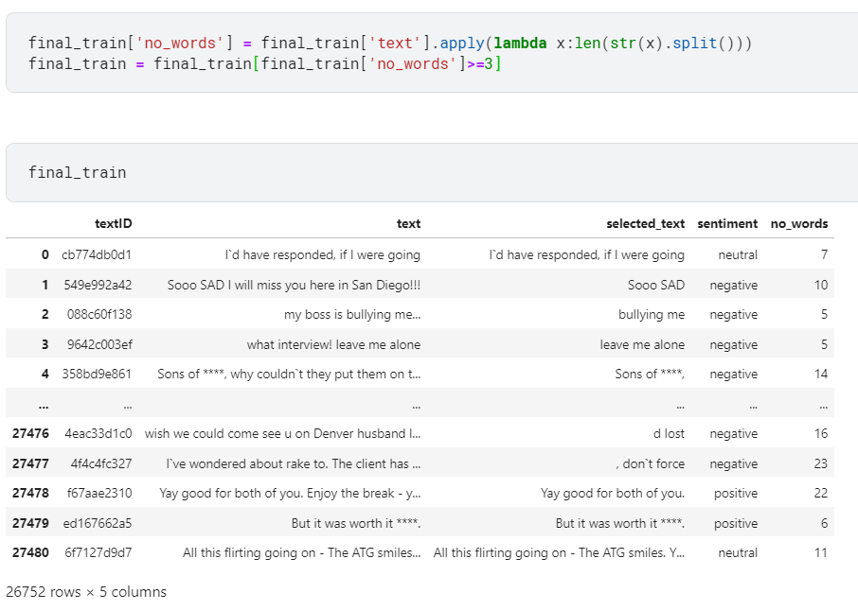
Same first steps as the previous model :

Slide 28
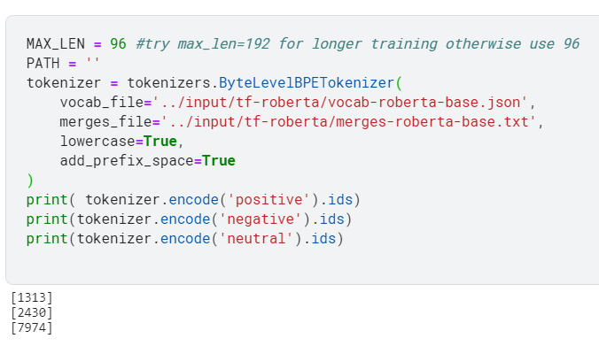
Set the settings of the tokenizer using Roberta files :
Give an id for each word and here save the ids of (pos/neg/neu) words

Slide 29
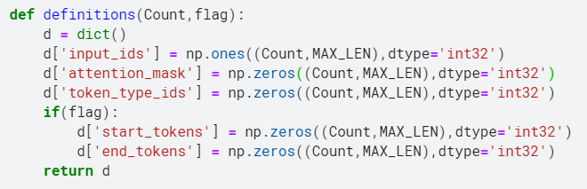
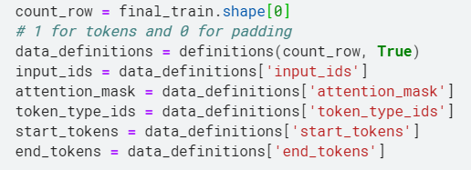
Initializing needed data :
Initialize the start_tokens and the end_tokens only if there exists selected text “flag is true “ .

Slide 30
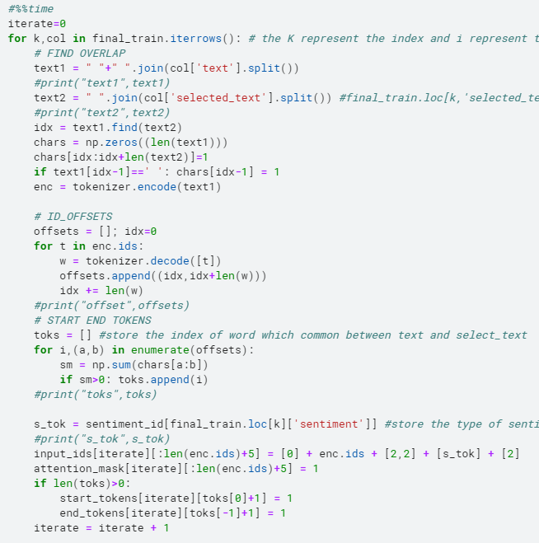
Preparing
Needed
data :

Slide 31
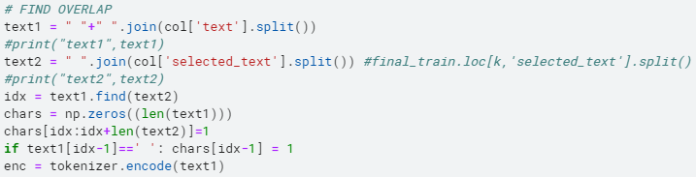

Looping in all rows of train data
Encode the text words and initialize chars array of length equals the text length with all zeros except the indices of selected text equals 1

Slide 32
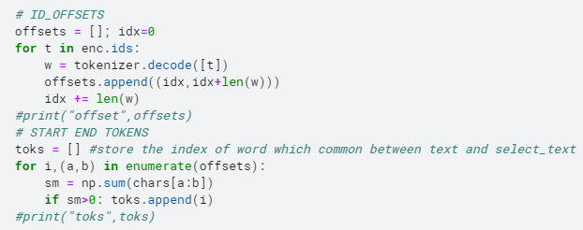
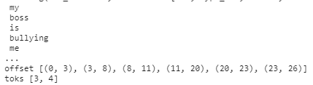
Decode the text , store the offsets and store indices of selected in toks

Slide 33
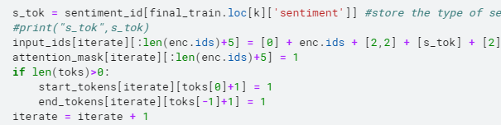
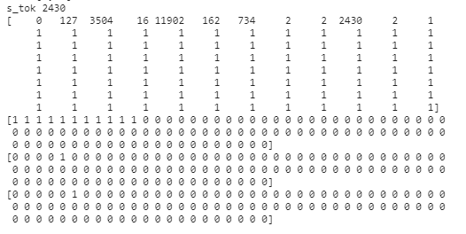
Set sentiment id of every train row in s_tok , use it to combine the input_ids , set the attention mask / start_tokens /end_tokens and add one to iterate

Slide 34
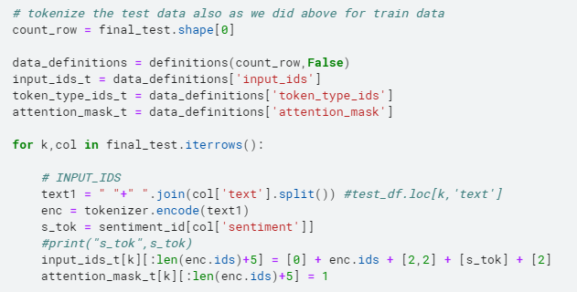
Do the same but for test data
Note : no selected text so there doesn’t exist start_tokens and end_tokens .

Slide 35
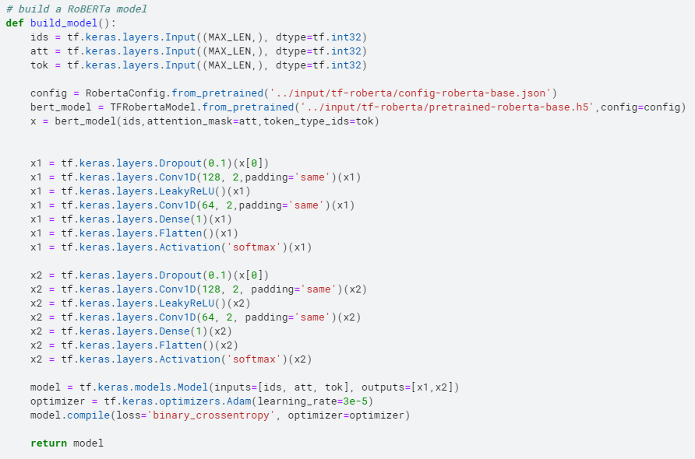
The model :

Slide 36
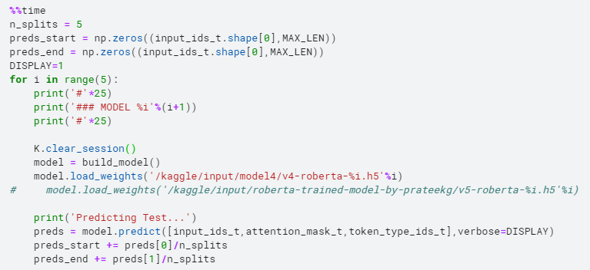
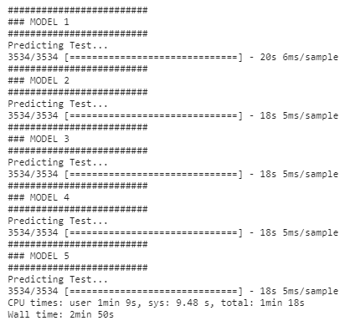
We built the model for 5 times :

Slide 37
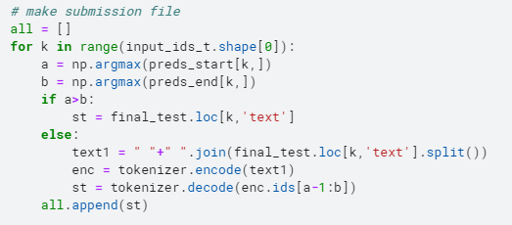
Make submission file :

Slide 38
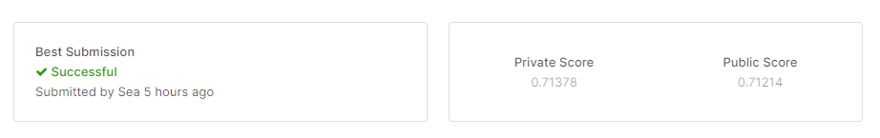
The Score of the submission :

Slide 39

Thanks

